Slide 1

Chapter 12:
Inventory Control Models
© 2007 Pearson Education

Slide 2
Inventory
Any stored resource used to satisfy a current or future need (raw materials, work-in-process, finished goods, etc.)
Represents as much as 50% of invested capitol at some companies
Excessive inventory levels are costly
Insufficient inventory levels lead to stockouts

Slide 3
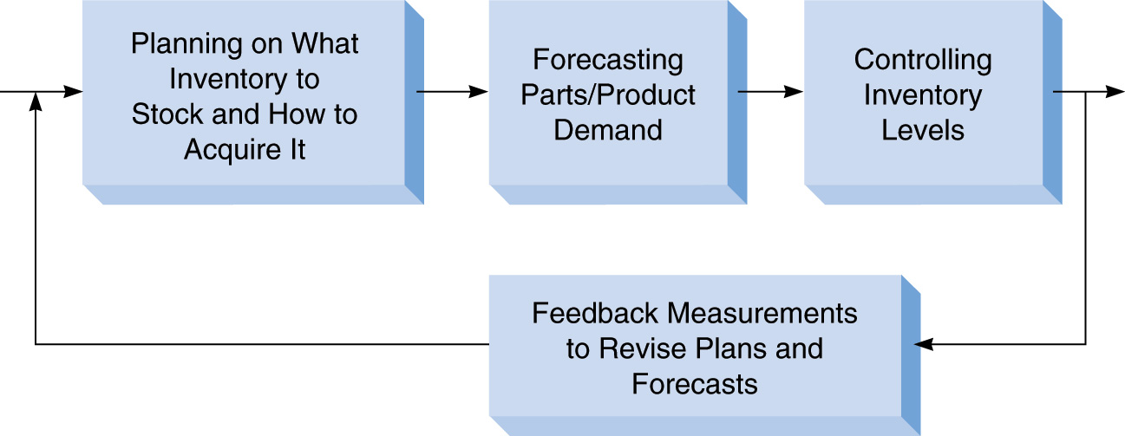
Inventory Planning and Control
For maintaining the right balance between high and low inventory to minimize cost

Slide 4
Main Uses of Inventory
The decoupling function
Storing resources
Irregular supply and demand
Quantity discounts
Avoiding stockouts and shortages

Slide 5
Inventory Control Decisions
Objective: Minimize total inventory cost
Decisions:
    How much to order?
    When to order?

Slide 6
Components of Total Cost
Cost of items
Cost of ordering
Cost of carrying or holding inventory
Cost of stockouts
Cost of safety stock (extra inventory held to help avoid stockouts)

Slide 7
Economic Order Quantity (EOQ): Determining How Much to Order
One of the oldest and most well known inventory control techniques
Easy to use
Based on a number of assumptions

Slide 8
Assumptions of the EOQ Model
Demand is known and constant
Lead time is known and constant
Receipt of inventory is instantaneous
Quantity discounts are not available
Variable costs are limited to: ordering cost and carrying (or holding) cost
If orders are placed at the right time, stockouts can be avoided

Slide 9
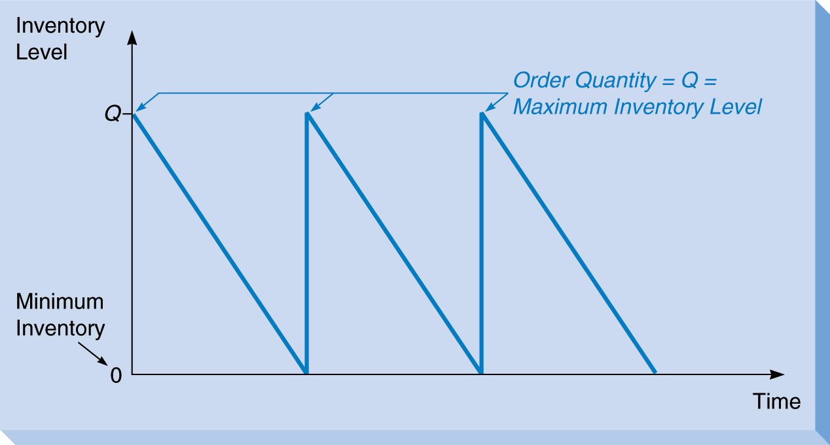
Inventory Level Over Time
Based on EOQ Assumptions

Slide 10
Minimizing EOQ Model Costs
Only ordering and carrying costs need to be minimized (all other costs are assumed constant)
As Q (order quantity) increases:
  Carry cost increases
  Ordering cost decreases (since the number of orders per year decreases)

Slide 11
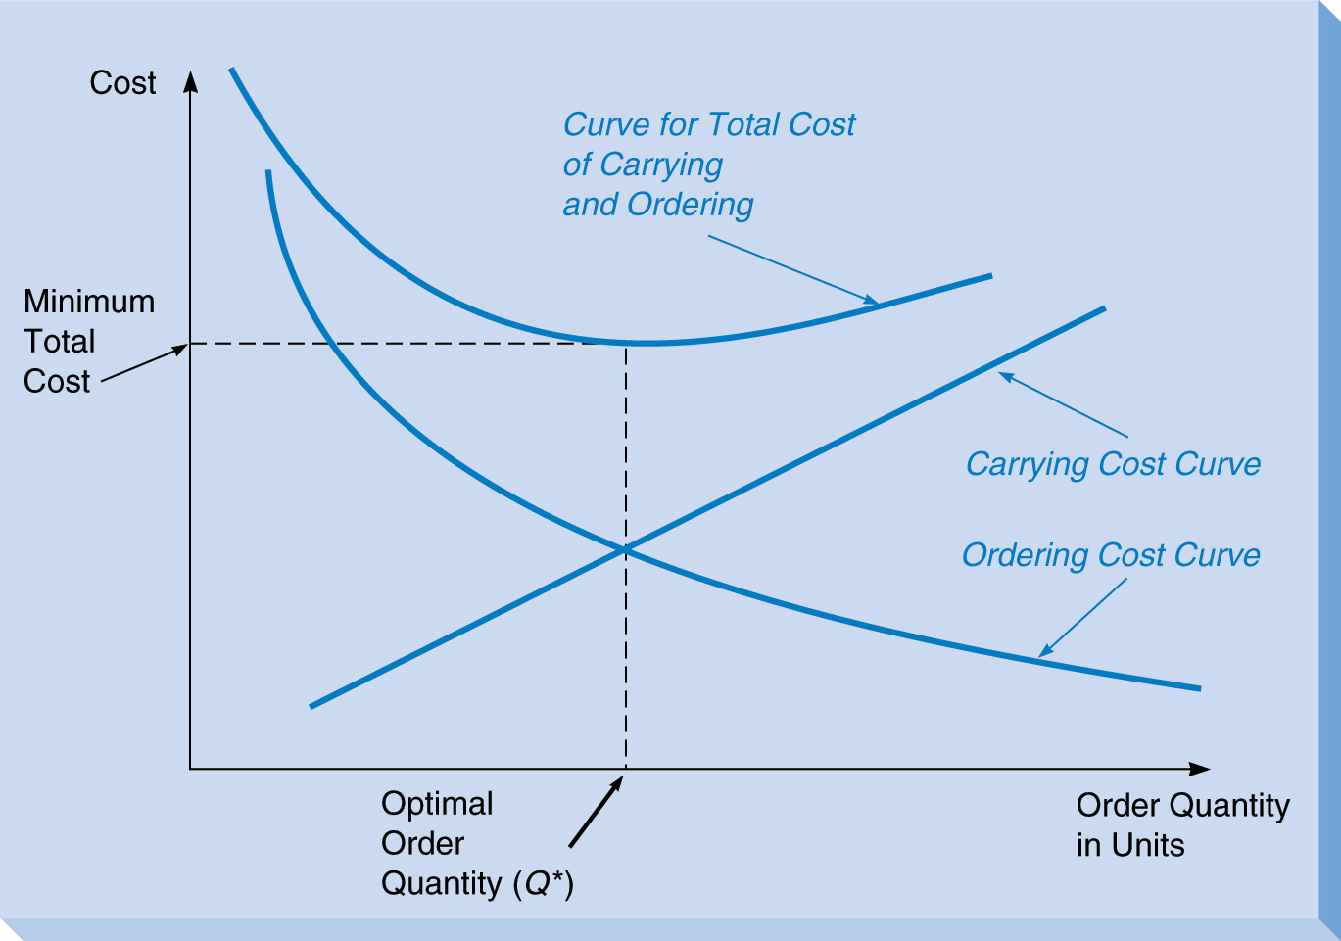
EOQ Model Total Cost
At optimal order quantity (Q*):
Carrying cost = Ordering cost

Slide 12
Finding the Optimal Order Quantity
Parameters:
Q* = Optimal order quantity (the EOQ)
D = Annual demand
C_{o} = Ordering cost per order
C_{h} = Carrying (or holding) cost per unit per yr
P = Purchase cost per unit

Slide 13
Two Methods for Carrying Cost
Carry cost (C_{h}) can be expressed either:
As a fixed cost, such as
C_{h} = $0.50 per unit per year
As a percentage of the item’s purchase cost (P)
C_{h} = I x P
I = a percentage of the purchase cost

Slide 14
EOQ Total Cost
Total ordering cost = (D/Q) x C_{o}
Total carrying cost = (Q/2) x C_{h}
Total purchase cost = P x D
= Total cost
Note:
(Q/2) is the average inventory level
Purchase cost does not depend on Q

Slide 15
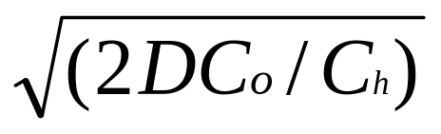
Finding Q*
Recall that at the optimal order quantity (Q*):
  Carry cost = Ordering cost
(D/Q*) x C_{o} = (Q*/2) x C_{h}
Rearranging to solve for Q*:
Q* =

Slide 16
EOQ Example: Sumco Pump Co.
Buys pump housing from a manufacturer and sells to retailers
D = 1000 pumps annually
C_{o} = $10 per order
C_{h} = $0.50 per pump per year
P = $5
Q* = ?

Slide 17
Using ExcelModules for Inventory
Worksheet for inventory models in ExcelModules are color coded
  Input cells are yellow
  Output cells are green
Select “Inventory Models” from the ExcelModules menu, then select “EOQ”
Go to file 12-2.xls

Slide 18
Average Inventory Value
After Q* is found we can calculate the average value of inventory on hand
Average inventory value = P x (Q*/2)

Slide 19
Calculating Ordering and
Carrying Costs for a Given Q
Sometimes C_{o} and C_{h} are difficult to estimate
We can use the EOQ formula to calculate the value of C_{o} or C_{h} that would make a given Q optimal:
C_{o} = Q² x C_{h}/(2D)
C_{h} = 2DC_{o}/Q²

Slide 20
Sensitivity of the EOQ Formula
The EOQ formula assumes all inputs are know with certainty
In reality these values are often estimates
Determining the effect of input value changes on Q* is called sensitivity analysis

Slide 21
Sensitivity Analysis for Sumco
Suppose C_{o} = $15 (instead of $10), which is a 50% increase
Assume all other values are unchanged
The new Q* = 245 (instead of 200), which is a 22.5% increase
This shows the nonlinear nature of the formula

Slide 22
Reorder Point:
Determining When to Order
After Q* is determined, the second decision is when to order
Orders must usually be placed before inventory reaches 0 due to order lead time
Lead time is the time from placing the order until it is received
The reorder point (ROP) depends on the lead time (L)

Slide 23
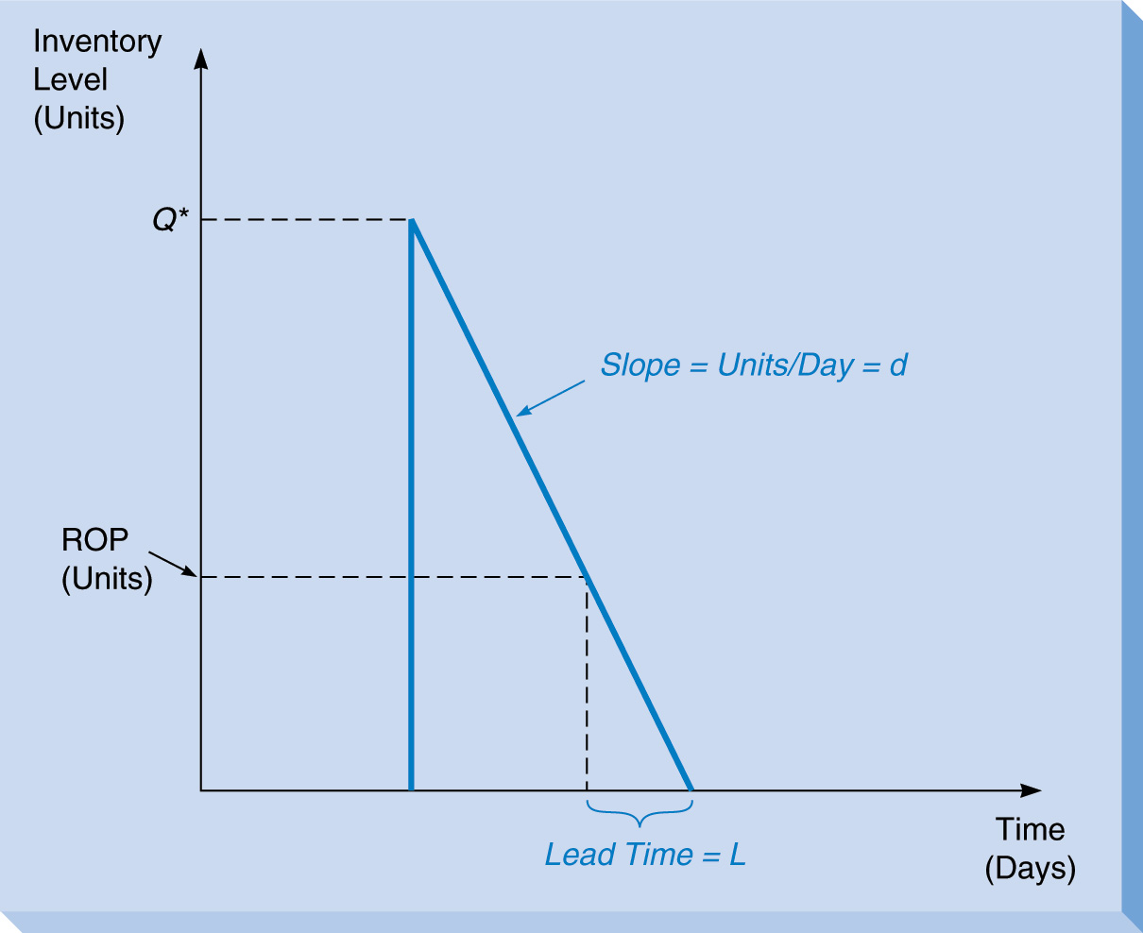
Reorder Point (ROP)
ROP = d x L

Slide 24
Sumco Example Revisited
Assume lead time, L = 3 business days
Assume 250 business days per year
Then daily demand,
d = 1000 pumps/250 days = 4 pumps per day
ROP = (4 pumps per day) x (3 days)
= 12 pumps
Go to file 12-3.xls

Slide 25
Economic Production Quantity:
Determining How Much to Produce
The EOQ model assumes inventory arrives instantaneously
In many cases inventory arrives gradually
The economic production quantity (EPQ) model assumes inventory is being produced at a rate of p units per day
There is a setup cost each time production begins

Slide 26
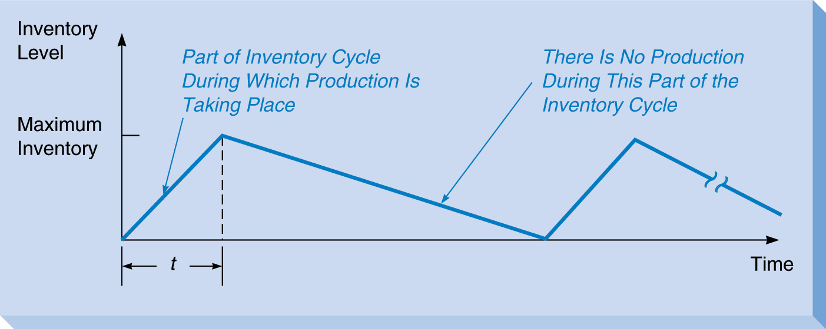
Inventory Control With Production

Slide 27
Determining Lot Size or EPQ
Parameters
Q* = Optimal production quantity (or EPQ)
C_{s} = Setup cost
D = annual demand
d = daily demand rate
p = daily production rate

Slide 28
Average Inventory Level
We will need the average inventory level for finding carrying cost
Average inventory level is ½ the maximum
Max inventory = Q x (1- d/p)
Ave inventory = ½ Q x (1- d/p)

Slide 29
Total Cost
Setup cost = (D/Q) x C_{s}
Carrying cost = [½ Q x (1- d/p)] x C_{h}
Production cost = P x D
= Total cost
As in the EOQ model:
The production cost does not depend on Q
The function is nonlinear

Slide 30
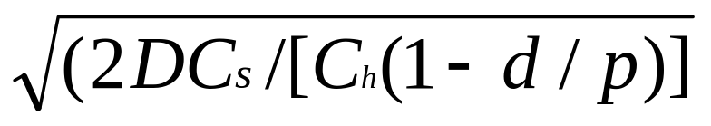
Finding Q*
As in the EOQ model, at the optimal quantity Q* we should have:
Setup cost = Carrying cost
(D/Q*) x C_{s} = [½ Q* x (1- d/p)] x C_{h}
Rearranging to solve for Q*:
Q* =

Slide 31
EPQ for Brown Manufacturing
Produces mini refrigerators (has 167 business days per year)
D = 10,000 units annually
d = 1000 / 167 = ~60 units per day
p = 80 units per day (when producing)
C_{h} = $0.50 per unit per year
C_{s} = $100 per setup
P = $5 to produce each unit
Go to file 12-4.xls

Slide 32
Length of the Production Cycle
The production cycle will last until Q* units have been produced
Producing at a rate of p units per day means that it will last (Q*/p) days
For Brown this is:
Q* = 4000 units
p = 80 units per day
4000 / 80 = 50 days

Slide 33
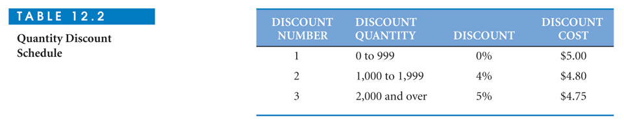
Quantity Discount Models
A quantity discount is a reduced unit price based on purchasing a large quantity
Example discount schedule:

Slide 34
Four Steps to Analyze
Quantity Discount Models
Calculate Q* for each discount price
If Q* is too small to qualify for that price, adjust Q* upward
Calculate total cost for each Q*
Select the Q* with the lowest total cost

Slide 35
Brass Department Store Example
Sells toy cars
D = 5000 cars annually
C_{o} = $49 per order
C_{h} = $0.20 per car per year
Quantity Discount Schedule
go to file 12-5.xls

Slide 36
Use of Safety Stock
Safety stock (SS) is extra inventory held to help prevent stockouts
Frequently demand is subject to random variability (uncertainty)
If demand is unusually high during lead time, a stockout will occur if there is no safety stock

Slide 37
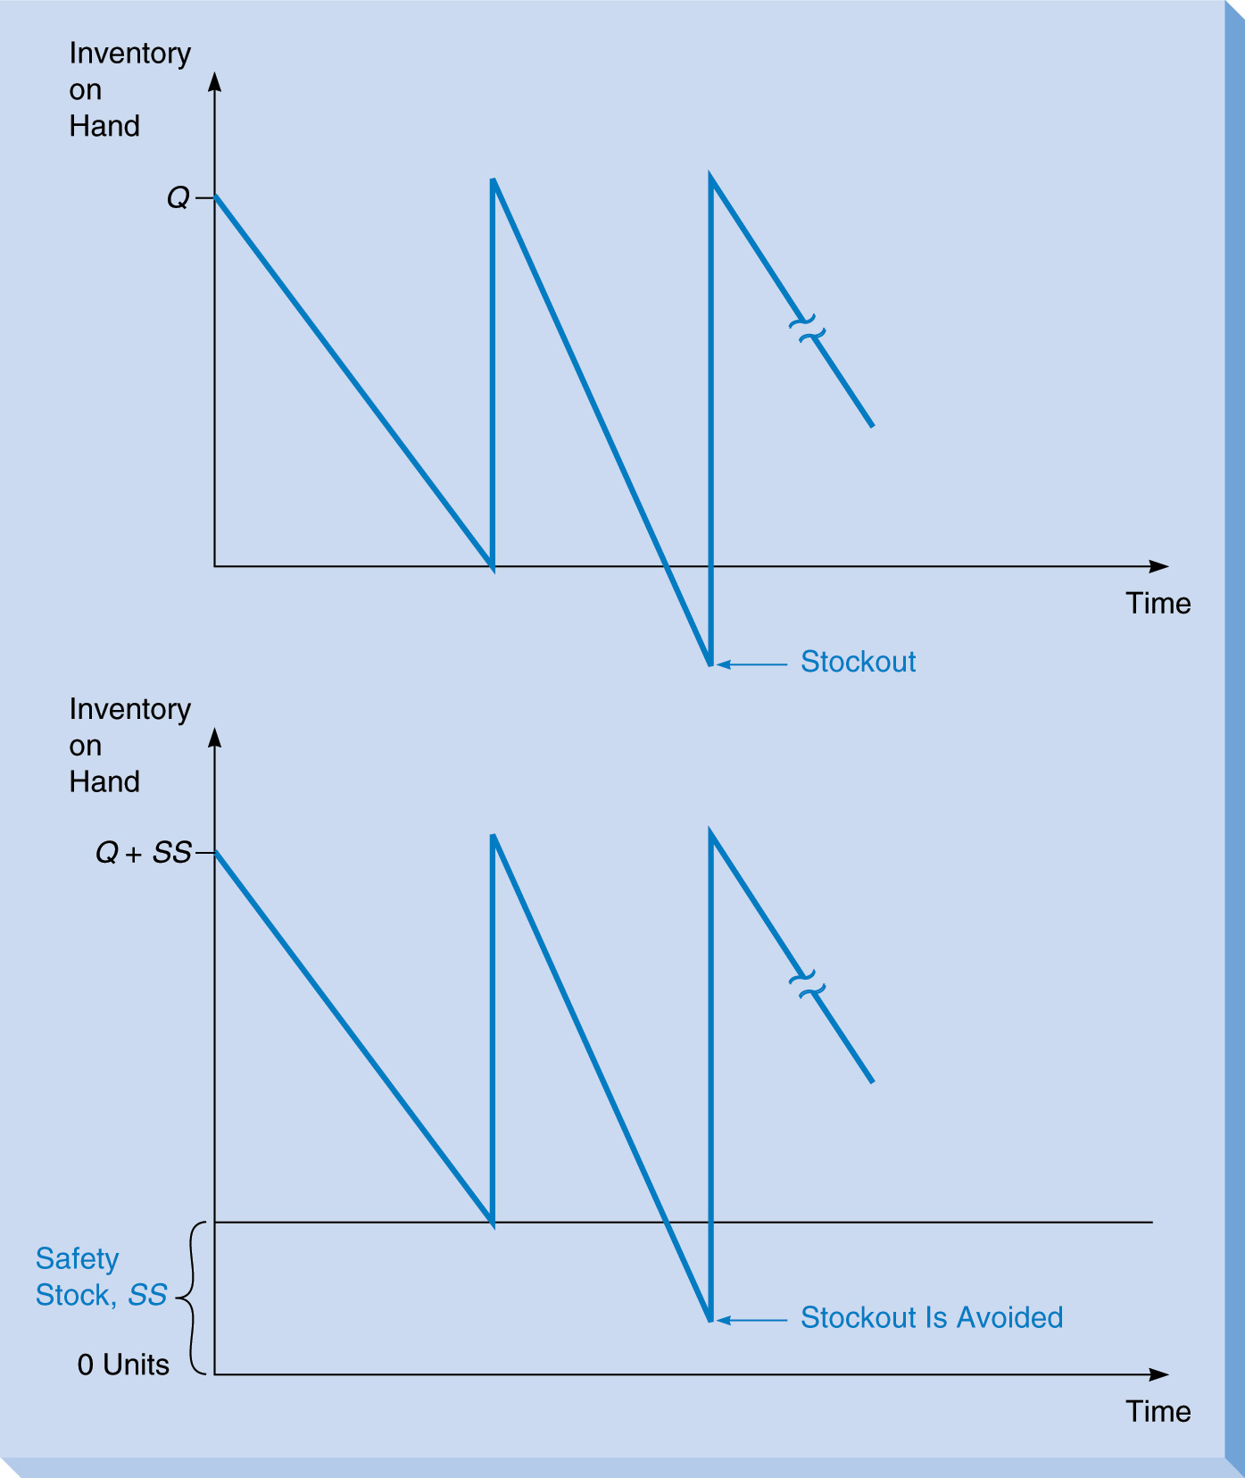
Use of Safety Stock

Slide 38
Determining Safety Stock Level
Need to know:
Probability of demand during lead time (DDLT)
Cost of a stockout (includes all costs directly or indirectly associated, such as cost of a lost sale and future lost sales)

Slide 39
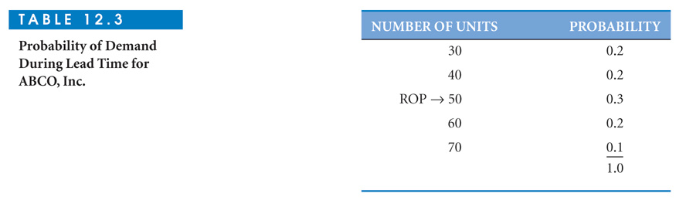
ABCO Safety Stock Example
ROP = 50 units (from previous EOQ)
Place 6 orders per year
Stockout cost per unit = $40
C_{h} = $5 per unit per year
DDLT has a discrete distribution

Slide 40
Analyzing the Alternatives
With uncertain DDLT this becomes a “decision making under risk” problem
Each of the five possible values of DDLT represents a decision alternative for ROP
Need to determine the economic payoff for each combination of decision alternative (ROP) and outcome (DDLT)

Slide 41
Stockout and Additional
Carrying Costs
 | Stockout Cost | Additional Carrying Cost
ROP = DDLT | 0 | 0
ROP < DDLT | $40 per unit short per year | 0
ROP > DDLT | 0 | $5 per unit per year
Go to file 12-6.xls

Slide 42
Safety Stock With
Unknown Stockout Costs
Determining stockout costs may be difficult or impossible
Customer dissatisfaction and possible future lost sales are difficult to estimate
Can use service level instead
Service level = 1 – probability of a stockout

Slide 43
Hinsdale Co. Example
DDLT follows a normal distribution
(μ = 350, σ = 10)
They want a 95% service level (i.e. 5% probability of a stockout)
SS = ?

Slide 44
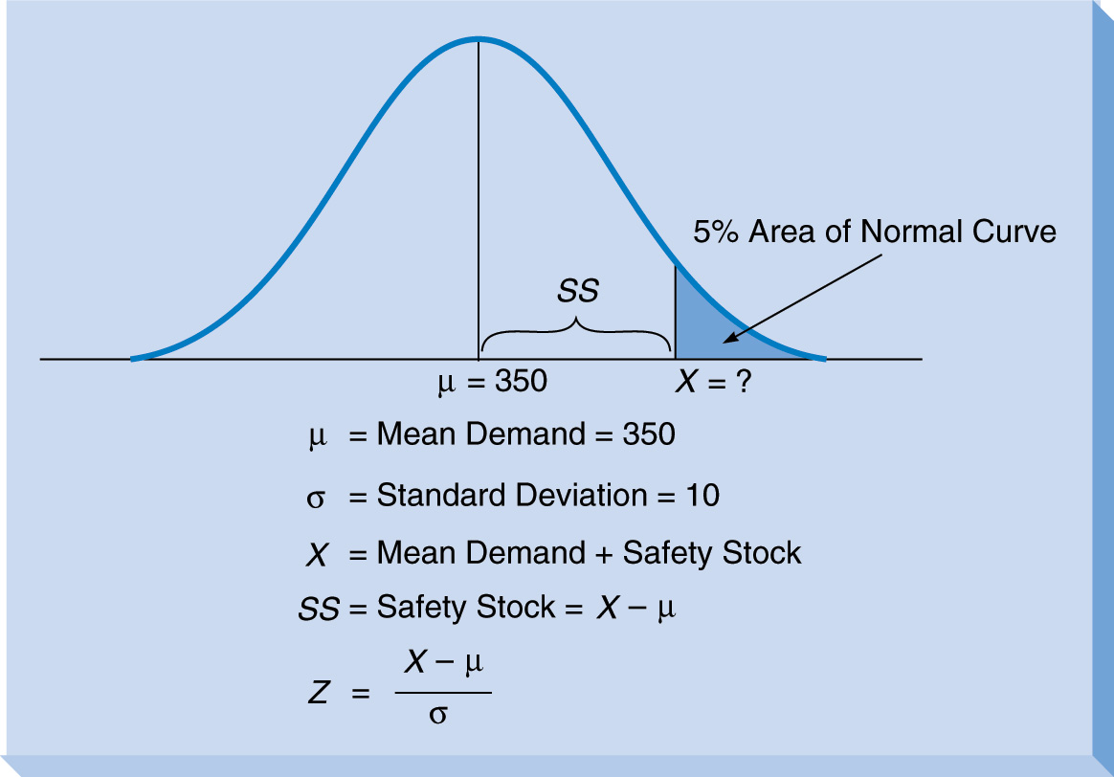
Safety Stock and the Normal Distribution

Slide 45
Calculating SS
From the standard Normal Table,
Z = 1.645 = X – 350 so X= 366.45
10
and, SS = 16.45 (which could be rounded to17)

Slide 46
Hinsdale’s Carrying Cost
Assume Hinsdale has a carrying cost of $1 per unit per year
We can calculate the SS and its carrying cost for various service levels

Slide 47
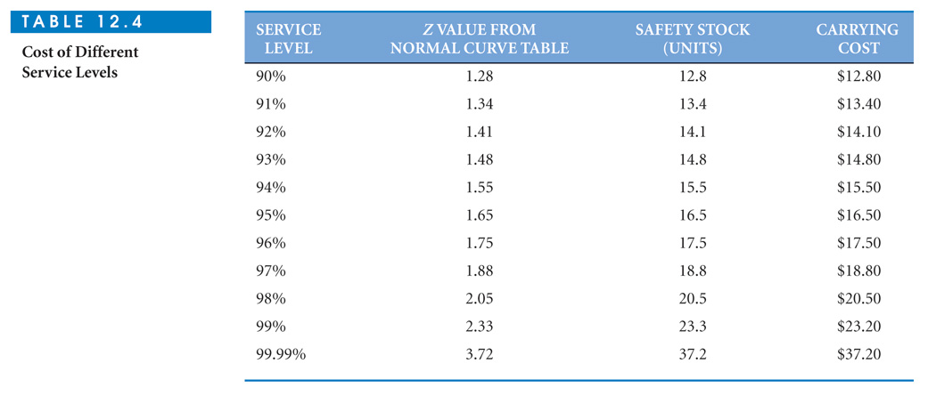
Cost of Different Service Levels

Slide 48
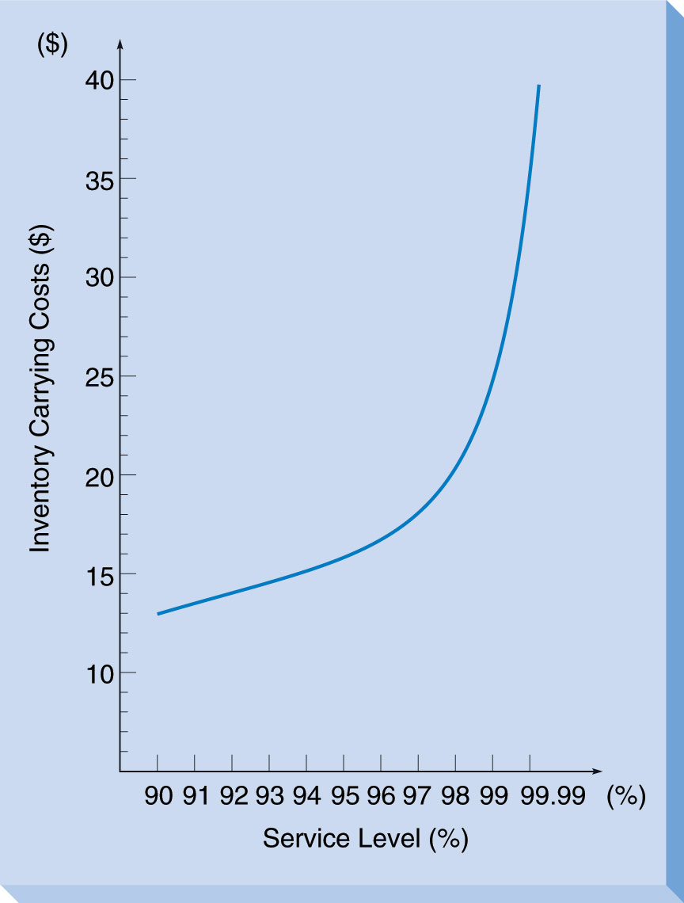
Carrying Cost Versus Service Level
Go to file 12-7.xls

Slide 49
ABC Analysis
Recognizes that some inventory items are more important than others
A group items are considered critical (often about 70% of dollar value and 10% of items)
B group items are important but not critical (often about 20% of dollar value and 20% of items)
C group items are not as important (often about 10% of dollar value and 70% of items)

Slide 50
Silicon Chips Inc. Example
Maker of super fast DRAM chips
Has 10 inventory items
Wants to classify them into A, B, and C groups
Calculate dollar value of each item and rank items

Slide 51
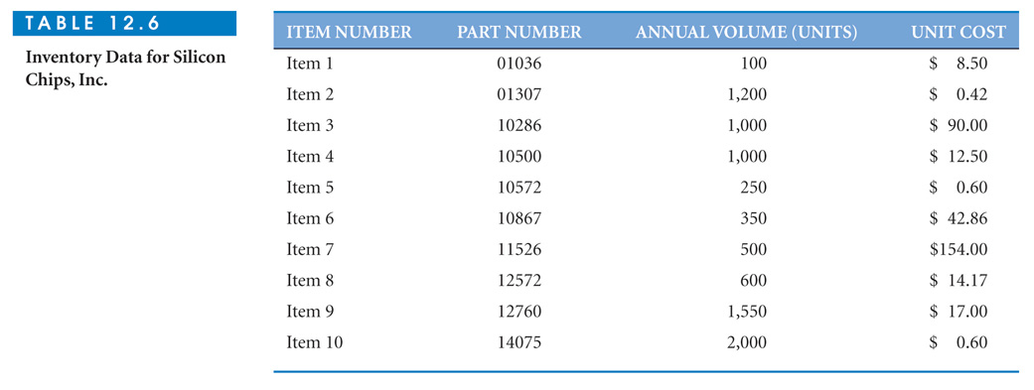
Inventory Items for Silicon Chips
Go to file 12-8.xls

